Slide 1
Manzarah

Slide 2
Not just caption generation
My project is not just focused on caption generation!
It focuses on an application that can be built to guide the visually impaired.

Slide 3
Voice to text
I have created the basic layout and prepared the model for the voice to text part of the application.

Slide 4
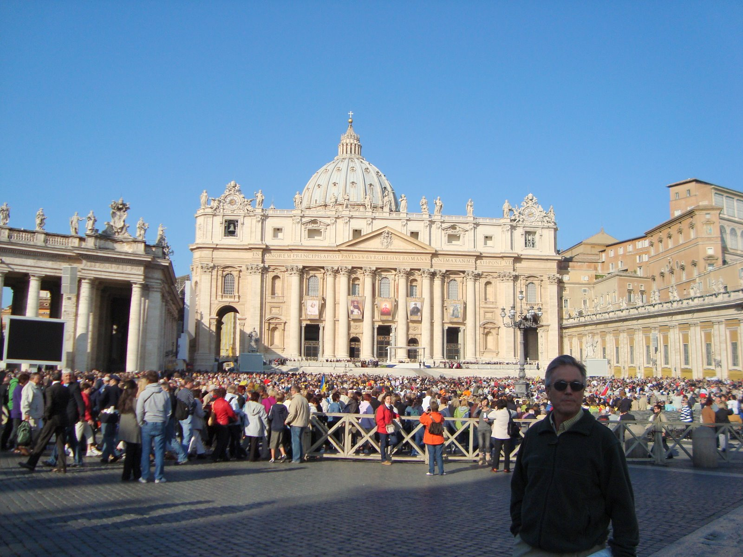
Take a picture

Slide 5
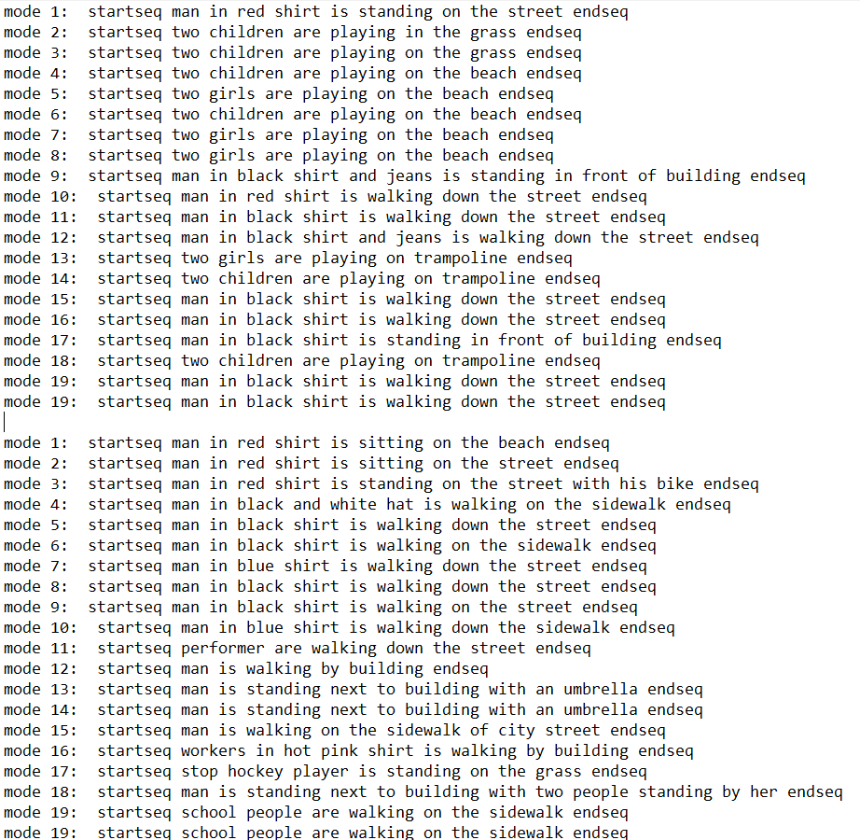
I am using multiple less trained model to extract information from picture
I get many captions and thus I have more information about image

Slide 6
Voice to text
Take user’s voice input, convert it into text. This will serve as a TEST caption.

Slide 7
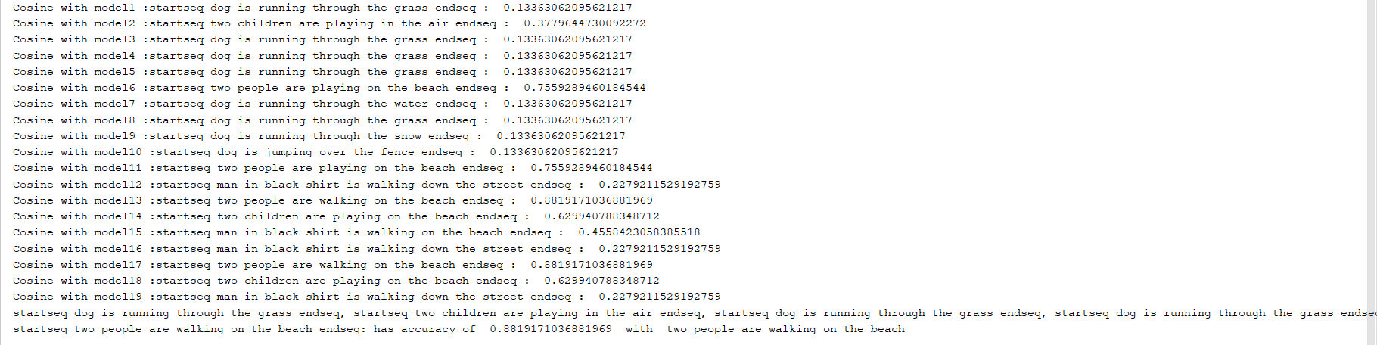
Cosine similarity
We will find cosine similarity of this USER INPUT with the captions generated
The caption with highest similarity will be returned as the caption of image!

Slide 8
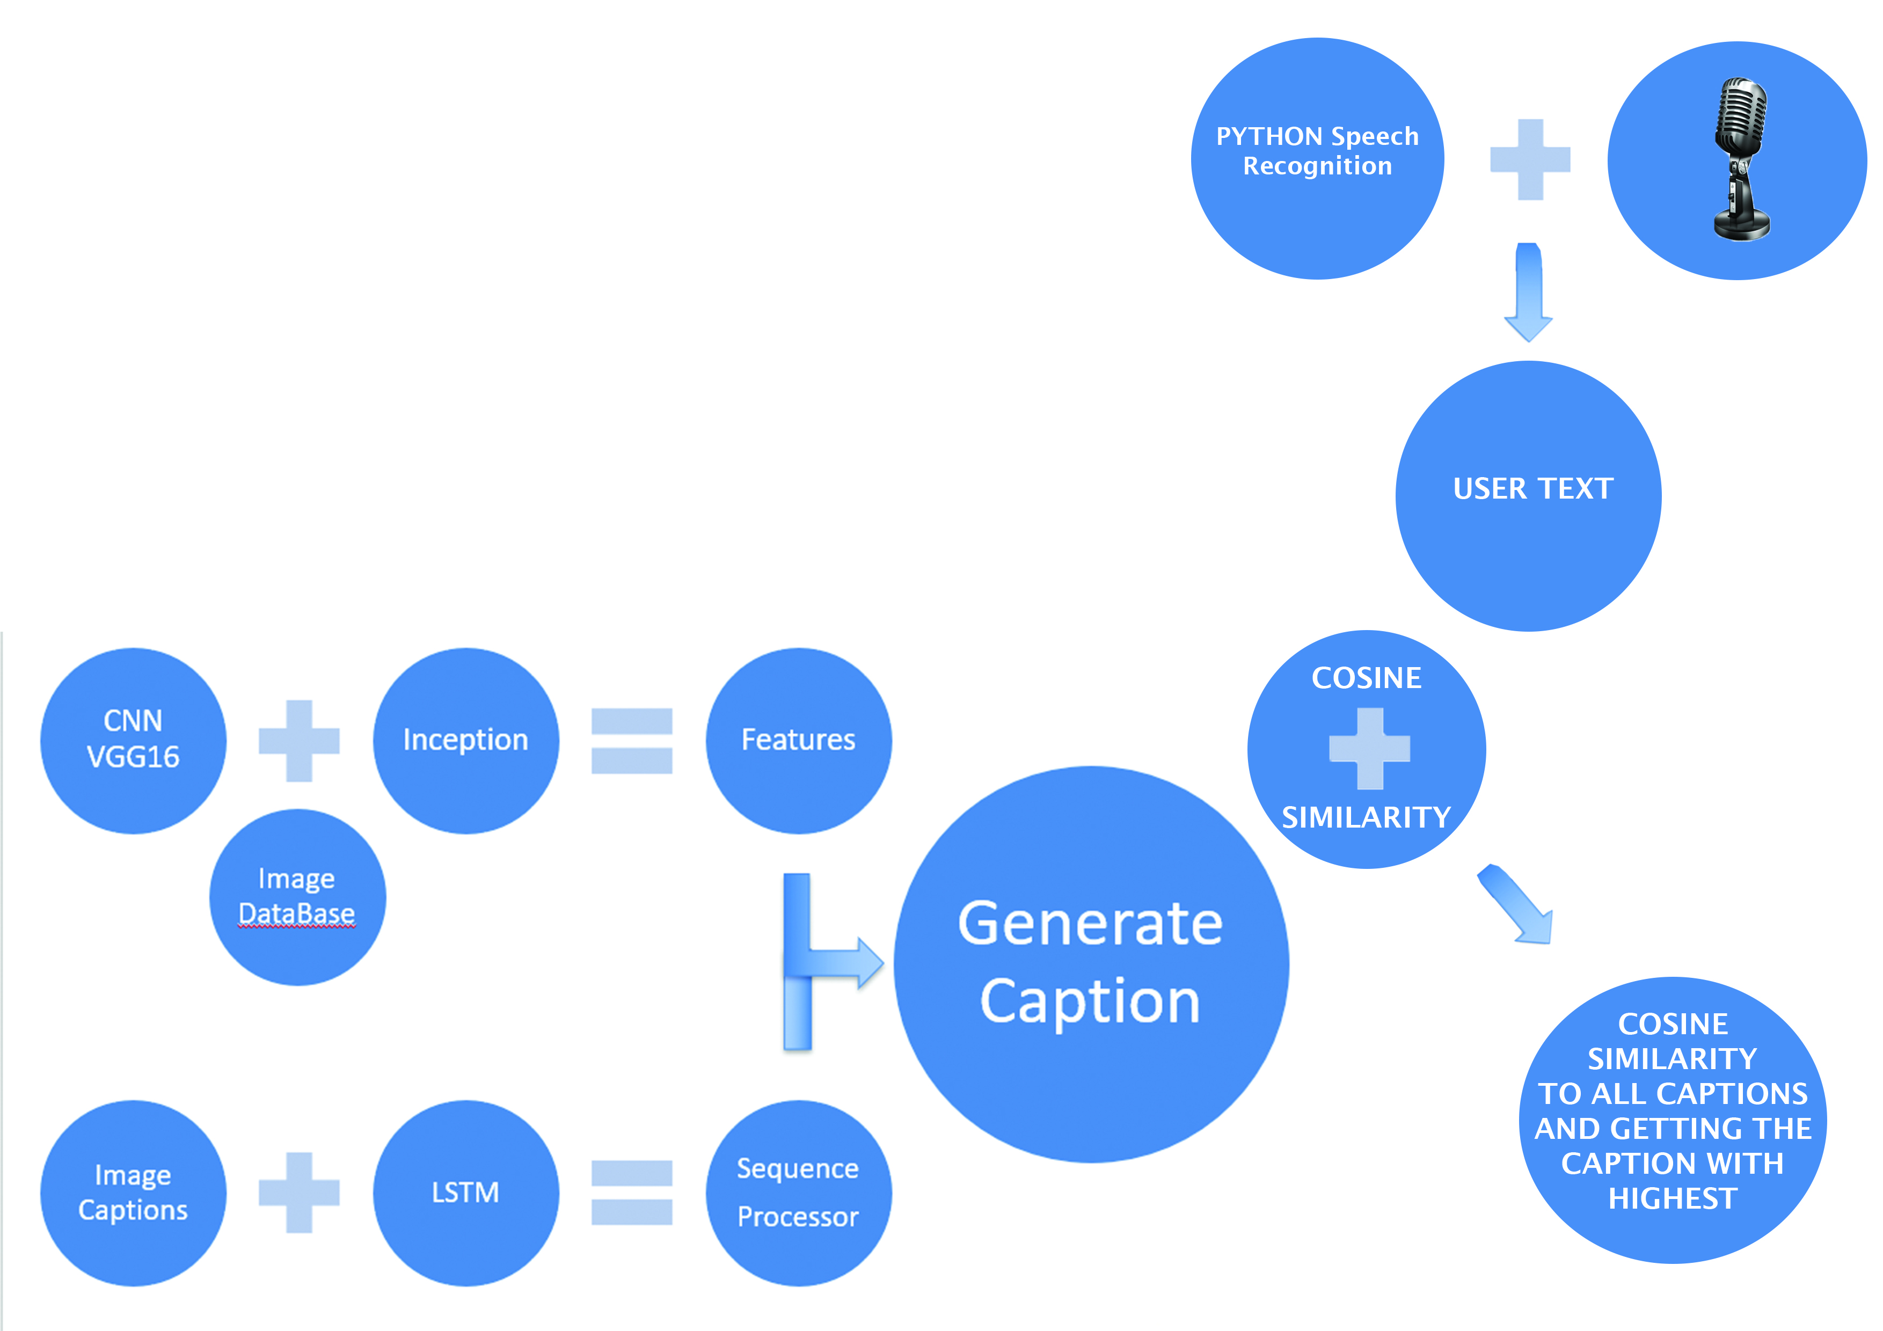

Slide 9
Long way to go
Due to time and complexity I am unable to create a complete application but I managed to create the basic model!
I have not been able to create an abstract summary of the captions to summarize the many captions into one single caption.
Once done, there needs to be a responsive software that can understand users question and then respond accordingly.
Finally a mobile application that can work as guide for visually impaired!

